Slide 1
Brief overview of the project and objectives:
The project is related to social media platforms, I choose this topic because it’s a trend nowadays.
The objectives is:
Track metrics related to reach, engagement rate.
Summarize sum, average and count for metrics such as likes, comments, shares, and engagement rate to understand how they works.
Track metrics related to follower age, engagement times, and sentiment analysis.

Slide 2
KPIs:
Reach
Engagement Rate
Sentiment Analysis
Regional Engagement

Slide 3
Data Collection
The data is about : Social media platforms engagement data.
Collecting source: Kaggle
The file format: Excel
Transformation: Deleting of some columns like(ID`s columns).

Slide 4
Dashboard Creation
Used the power BI desktop app to develop a creative dashboard in order to represent the data visually so the managers can make a decision based on it .
In respect to KPIs.

Slide 5
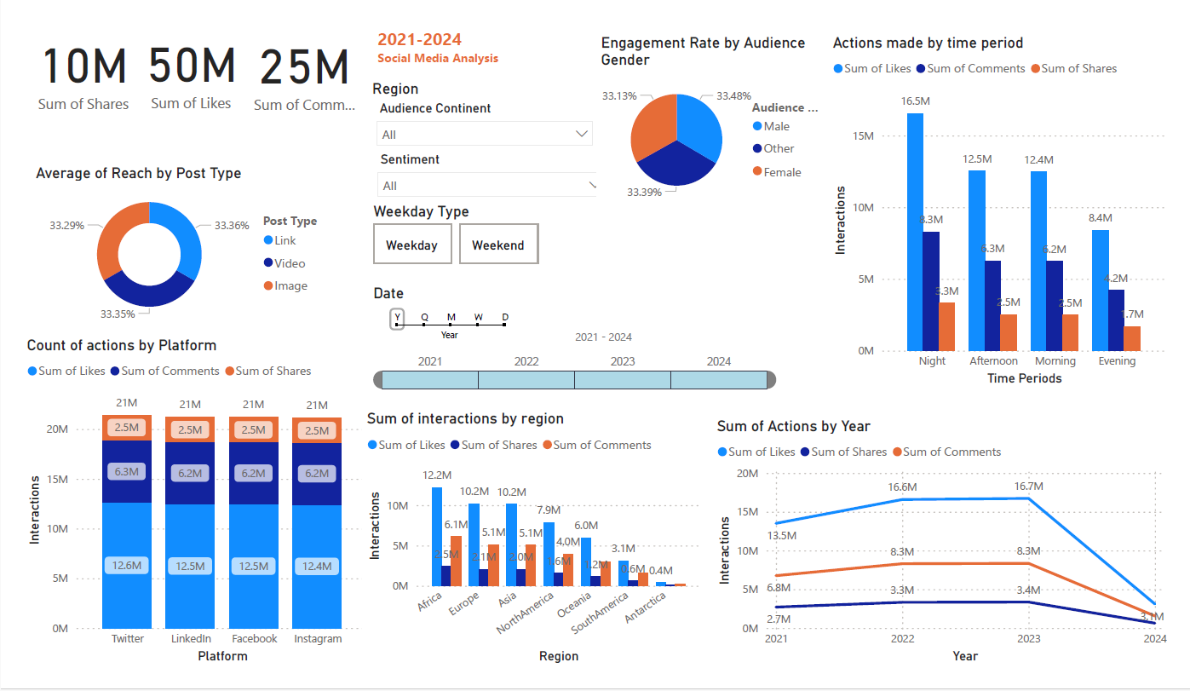

Slide 6
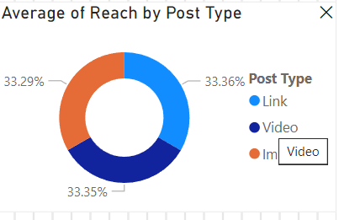
Insights and Analysis
Donut chart findings:
whatever the post type the average of post reach is quietly the same.

Slide 7
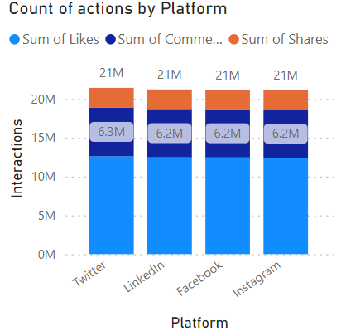
Insights and Analysis
Clustered bar chart findings:
Between these interactions (likes, comments and shares)
it seemed that the likes action has the highest sum comparing of
Other interactions, so it seems that people like to do likes
than other actions.
Note : there is no relationship between platform type and count of interactions .

Slide 8
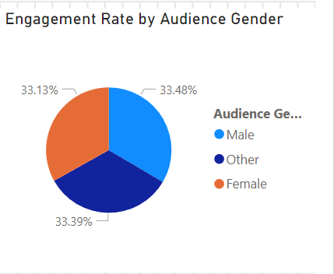
Insights and Analysis
Pie chart findings:
Engagement rate are equal between all genders, the chart measures
the rate of engagement that users do depends on their gender.

Slide 9
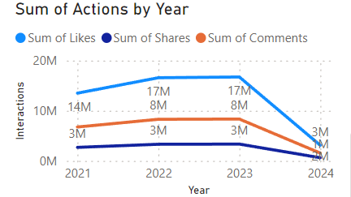
Insights and Analysis
Line chart findings:
The sum of interactions taken go down by year
So, they might find a new ways to attract people,
by advertising or other keys changing.

Slide 10
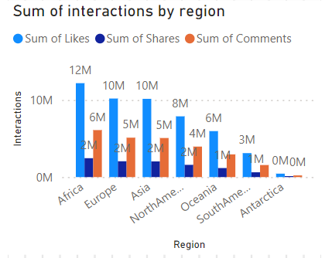
Insights and Analysis
Clustered Bar chart findings:
Sum of interactions by region.
The analysis revealed variations in engagement levels
across different regions, with Africa
showing the highest sum of interactions.
This suggests that there may be regional differences in
audience behaviour and preferences that should be taken into
account when tailoring content and marketing strategies.

Slide 11
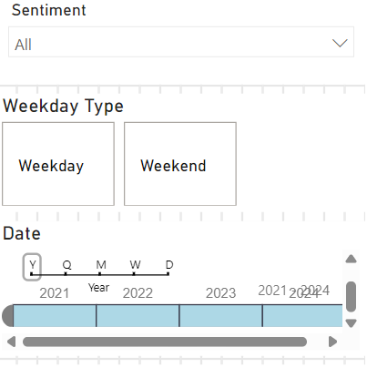
Insights and Analysis
Slicers findings:
Slicers helped to summarize the data based on the region, the sentiment, and year.
So if I applied the slicer of the year 2024 comparing to year 2021 we will found that the 2024 has lower overall interactions than 2021.(negative relationship)
From the slicer of the weekday type, it seemed that people in weekday tend to do likes (or other interactions) half in average than the weekend. Especially at night.
So, from that the manager could decide to not make many posts during weekend because people tend to interact on weekday more.

Slide 12
Conclusion: Summary of the project outcomes, challenges faced, and lessons learned.
The analysis revealed that there is a decline in the overall interactions (likes, comments, shares) over the years, indicating a potential decrease in audience engagement with social media content.
The analysis showed that likes are the most common form of interaction across all post types, while shares have the lowest frequency. This suggests that users are more inclined to engage with content by liking it rather than sharing it. The engagement rate was found to be consistent across all genders.
The analysis revealed variations in engagement levels across different regions, with Africa showing the highest sum of interactions
The analysis showed that people tend to engage more with social media content during weekdays compared to weekends, particularly during the night.
these insights can inform decisions about the timing of content posting and marketing campaigns to maximize engagement.

Slide 13
One of the primary challenges is ensuring the quality and reliability of the data. Analysing social media data involves dealing with large volumes of data, complex relationships between variables, and diverse types of analysis techniques. Challenge in deal with relationships between attributes. Tried to make correlation using excel first to find a relationship between variables. You have to define clear objectives and selecting relevant key metrics, so you can create a social media report dashboard that provides actionable insights and helps guide the social media strategy towards achieving the business goals.
Conclusion: Summary of the project outcomes, challenges faced, and lessons learned.
Challenging faced:

Slide 14
Conclusion: Summary of the project outcomes, challenges faced, and lessons learned. The social media is a huge aspect to discuss needs a huge amount of data to make a conclusion about something why happens, or might be happen Analysing the data by powerBI helped in visualize the roughed rows and columns to something understood and clear The decision making by managers will be easier with this visualization.

Slide 15
Thank You..!

